Slide 1

Data Analytics Coaching Course

Slide 2
Module 6: Introduction to Power BI/Tableau
By the end of this guide, you’ll confidently get to know:
Overview of BI Tools (Power BI vs Tableau)
Connecting to Data (Excel, CSV, SQL, etc.)
Data Transformation using Power Query

Slide 3
1. Overview of BI Tools: Power BI and Tableau
What Are BI (Business Intelligence) Tools?
BI tools help you:
Visualize data (dashboards, charts, KPIs)
Analyze business performance
Make data-driven decisions
They sit on top of your data sources (Excel, databases, cloud storage, etc.), allowing non-technical users to gain insights without writing code.

Slide 4
Power BI vs Tableau: A Comparison
Feature | Power BI | Tableau
Developer | Microsoft | Salesforce
Learning Curve | Easier for beginners | Steeper but highly flexible
Best For | Excel and Microsoft Ecosystem users | Data Visualization Enthusiasts
Integration | Strong with Excel, SQL Server, Azure | Strong with diverse data sources
Cost | Cheaper (PowerBI Desktop is free) | Expensive for enterprise
Data Modelling | Excellent (DAX, Power Query) | Greater but less stronger than Power BI
Visualization | Good and improving | Industry leaders for visuals

Slide 5
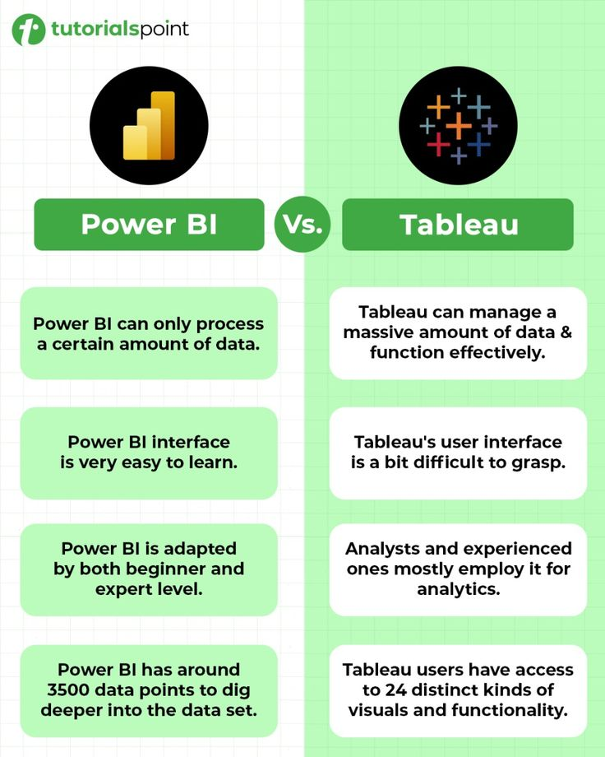
Power BI vs Tableau: A Comparison
🧠 Key Insight:
If you already know Excel or work in a Microsoft-heavy environment, Power BI is the most natural and cost-effective BI tool to learn.

Slide 6
PowerBI Insight
Use Excel when your goal is data entry, quick analysis, or small-scale reporting. Excel is best suited for individual or team-based analysis, ad-hoc calculations, and detailed tabular work where you need flexibility to manipulate data manually — such as budgeting, forecasting, and small datasets.
Use Power BI when your goal is interactive data visualization, automation, and large-scale data analysis. Power BI is ideal for connecting to multiple data sources, cleaning and modeling data efficiently, and creating live, interactive dashboards that can be shared across an organization. It’s designed for ongoing business intelligence rather than one-time reporting.
Notes:
There are three main types of data you'll encounter:
Structured Data: This is highly organized and formatted data that fits into a fixed structure, like a table. Think of a spreadsheet or a database. Each piece of data has a clear relationship to other data. Examples include customer names, addresses, and product prices in a database.
Unstructured Data: This is data that doesn't have a pre-defined format or organization. It's often text-heavy and includes things like emails, social media posts, videos, and audio files. It's the most common type of data and can be a goldmine for insights, though it's harder to analyze.
Semi-structured Data: This type of data has some organizational properties but isn't as strictly defined as structured data. It doesn't reside in a relational database but contains tags or markers to separate and organize elements. A good example is a JSON file or an XML file, which are often used for web data exchange.

Slide 7
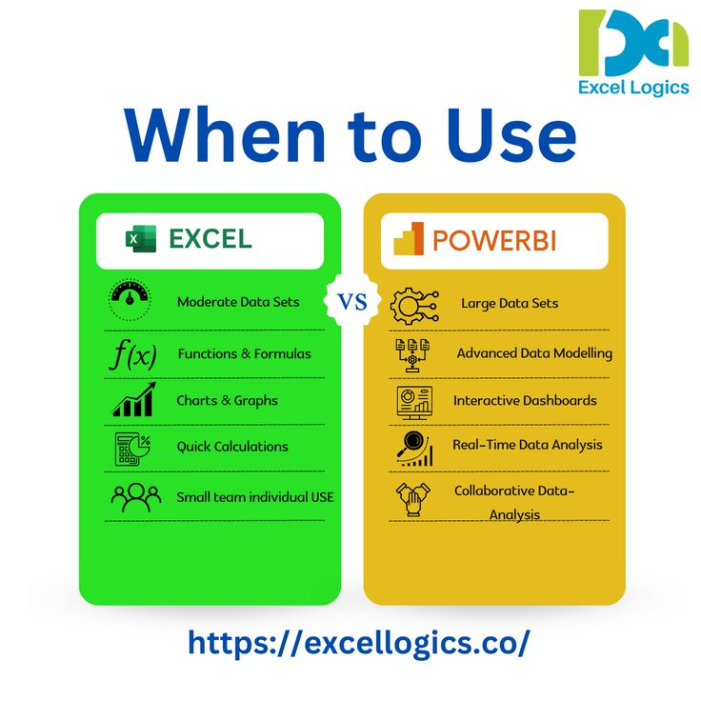
PowerBI Insight
Use Excel for analysis — use Power BI for insight.
Excel helps you analyze data, while Power BI helps you tell the story behind it through automation and visualization.
Notes:
There are three main types of data you'll encounter:
Structured Data: This is highly organized and formatted data that fits into a fixed structure, like a table. Think of a spreadsheet or a database. Each piece of data has a clear relationship to other data. Examples include customer names, addresses, and product prices in a database.
Unstructured Data: This is data that doesn't have a pre-defined format or organization. It's often text-heavy and includes things like emails, social media posts, videos, and audio files. It's the most common type of data and can be a goldmine for insights, though it's harder to analyze.
Semi-structured Data: This type of data has some organizational properties but isn't as strictly defined as structured data. It doesn't reside in a relational database but contains tags or markers to separate and organize elements. A good example is a JSON file or an XML file, which are often used for web data exchange.

Slide 8
2. Connecting Power BI to Data
Power BI lets you connect to over 100+ data sources. Let’s focus on the most common ones for Data Analysis.
🧾 A. Connect to Excel or CSV
Open Power BI Desktop.
Click Home → Get Data → Excel (or CSV).
Browse and select your file.
Choose the worksheet or table.
Click Load (or Transform Data if you want to clean first).
✅ Best for: Small datasets, manual uploads, static data.
Notes:
There are three main types of data you'll encounter:
Structured Data: This is highly organized and formatted data that fits into a fixed structure, like a table. Think of a spreadsheet or a database. Each piece of data has a clear relationship to other data. Examples include customer names, addresses, and product prices in a database.
Unstructured Data: This is data that doesn't have a pre-defined format or organization. It's often text-heavy and includes things like emails, social media posts, videos, and audio files. It's the most common type of data and can be a goldmine for insights, though it's harder to analyze.
Semi-structured Data: This type of data has some organizational properties but isn't as strictly defined as structured data. It doesn't reside in a relational database but contains tags or markers to separate and organize elements. A good example is a JSON file or an XML file, which are often used for web data exchange.

Slide 9
2. Connecting Power BI to Data
🗄️ B. Connect to SQL Database
Home → Get Data → SQL Server
Enter:
Server Name (e.g., localhost or DESKTOP-XYZ123)
Database Name (optional)
Choose Import or DirectQuery:
Import → Loads data into Power BI (faster for analysis)
DirectQuery → Connects live (best for large databases)
Click OK, choose your tables, and Load.
✅ Best for: Enterprise data, dynamic updates, real-time dashboards.
Notes:
There are three main types of data you'll encounter:
Structured Data: This is highly organized and formatted data that fits into a fixed structure, like a table. Think of a spreadsheet or a database. Each piece of data has a clear relationship to other data. Examples include customer names, addresses, and product prices in a database.
Unstructured Data: This is data that doesn't have a pre-defined format or organization. It's often text-heavy and includes things like emails, social media posts, videos, and audio files. It's the most common type of data and can be a goldmine for insights, though it's harder to analyze.
Semi-structured Data: This type of data has some organizational properties but isn't as strictly defined as structured data. It doesn't reside in a relational database but contains tags or markers to separate and organize elements. A good example is a JSON file or an XML file, which are often used for web data exchange.

Slide 10
2. Connecting Power BI to Data
☁️ C. Connect to Online Sources (Optional)
SharePoint / OneDrive
Azure SQL
Google Analytics
Salesforce
Web URLs / APIs
💡 Example: To connect to a web source (like a CSV online):
Go to Get Data → Web
Paste the URL
Click OK
Notes:
There are three main types of data you'll encounter:
Structured Data: This is highly organized and formatted data that fits into a fixed structure, like a table. Think of a spreadsheet or a database. Each piece of data has a clear relationship to other data. Examples include customer names, addresses, and product prices in a database.
Unstructured Data: This is data that doesn't have a pre-defined format or organization. It's often text-heavy and includes things like emails, social media posts, videos, and audio files. It's the most common type of data and can be a goldmine for insights, though it's harder to analyze.
Semi-structured Data: This type of data has some organizational properties but isn't as strictly defined as structured data. It doesn't reside in a relational database but contains tags or markers to separate and organize elements. A good example is a JSON file or an XML file, which are often used for web data exchange.

Slide 11
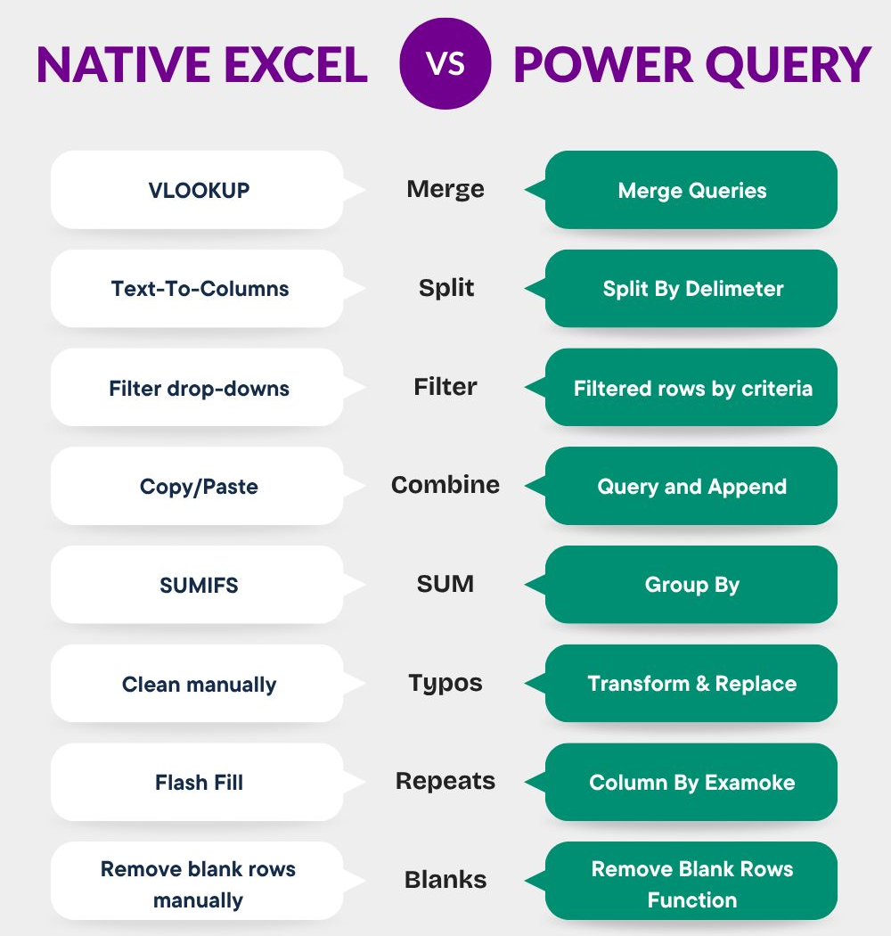
3. Data Transformation (Power Query)
This is one of the most powerful features in Power BI — your data cleaning and preparation hub.
Notes:
There are three main types of data you'll encounter:
Structured Data: This is highly organized and formatted data that fits into a fixed structure, like a table. Think of a spreadsheet or a database. Each piece of data has a clear relationship to other data. Examples include customer names, addresses, and product prices in a database.
Unstructured Data: This is data that doesn't have a pre-defined format or organization. It's often text-heavy and includes things like emails, social media posts, videos, and audio files. It's the most common type of data and can be a goldmine for insights, though it's harder to analyze.
Semi-structured Data: This type of data has some organizational properties but isn't as strictly defined as structured data. It doesn't reside in a relational database but contains tags or markers to separate and organize elements. A good example is a JSON file or an XML file, which are often used for web data exchange.

Slide 12
3. Data Transformation (Power Query)
What Is Power Query?
Power Query is a visual ETL (Extract, Transform, Load) tool built inside Power BI that lets you:
Remove duplicates
Change data types
Merge tables
Split columns
Handle missing data
Create calculated columns
You don’t need to code — transformations are step-based and visual.
Notes:
There are three main types of data you'll encounter:
Structured Data: This is highly organized and formatted data that fits into a fixed structure, like a table. Think of a spreadsheet or a database. Each piece of data has a clear relationship to other data. Examples include customer names, addresses, and product prices in a database.
Unstructured Data: This is data that doesn't have a pre-defined format or organization. It's often text-heavy and includes things like emails, social media posts, videos, and audio files. It's the most common type of data and can be a goldmine for insights, though it's harder to analyze.
Semi-structured Data: This type of data has some organizational properties but isn't as strictly defined as structured data. It doesn't reside in a relational database but contains tags or markers to separate and organize elements. A good example is a JSON file or an XML file, which are often used for web data exchange.

Slide 13
3. Data Transformation (Power Query)
⚡ Entering Power Query Editor
In Power BI Desktop:
After loading data, click Transform Data → opens the Power Query Editor.
You’ll see:
Left panel: list of tables (queries)
Center: data preview
Right panel: list of transformation steps
Notes:
There are three main types of data you'll encounter:
Structured Data: This is highly organized and formatted data that fits into a fixed structure, like a table. Think of a spreadsheet or a database. Each piece of data has a clear relationship to other data. Examples include customer names, addresses, and product prices in a database.
Unstructured Data: This is data that doesn't have a pre-defined format or organization. It's often text-heavy and includes things like emails, social media posts, videos, and audio files. It's the most common type of data and can be a goldmine for insights, though it's harder to analyze.
Semi-structured Data: This type of data has some organizational properties but isn't as strictly defined as structured data. It doesn't reside in a relational database but contains tags or markers to separate and organize elements. A good example is a JSON file or an XML file, which are often used for web data exchange.

Slide 14
3. Data Transformation (Power Query)
⚡ Entering Power Query Editor
Task | Action in Power Query
Rename Columns | Double-click column header or use “Rename”
Change Data Type | Select column → Transform → Data Type
Remove Duplicates | Home → Remove Rows → Remove Duplicates
Filter Rows | Click dropdown on column headers
Split Columns | Home → Split Column (by delimiter or number)
Notes:
There are three main types of data you'll encounter:
Structured Data: This is highly organized and formatted data that fits into a fixed structure, like a table. Think of a spreadsheet or a database. Each piece of data has a clear relationship to other data. Examples include customer names, addresses, and product prices in a database.
Unstructured Data: This is data that doesn't have a pre-defined format or organization. It's often text-heavy and includes things like emails, social media posts, videos, and audio files. It's the most common type of data and can be a goldmine for insights, though it's harder to analyze.
Semi-structured Data: This type of data has some organizational properties but isn't as strictly defined as structured data. It doesn't reside in a relational database but contains tags or markers to separate and organize elements. A good example is a JSON file or an XML file, which are often used for web data exchange.

Slide 15
3. Data Transformation (Power Query)
⚡ Entering Power Query Editor
Task | Action in Power Query
Merge Queries | Home → Merge Queries → choose key column
Append Queries | Combine datasets vertically
Fill Missing Values | Transform → Fill → Down/Up
Add Custom Column | Add Column → Custom Column (use M formula)
Power Query uses the “M language” behind the scenes — but you can do 99% of work without typing code.
Notes:
There are three main types of data you'll encounter:
Structured Data: This is highly organized and formatted data that fits into a fixed structure, like a table. Think of a spreadsheet or a database. Each piece of data has a clear relationship to other data. Examples include customer names, addresses, and product prices in a database.
Unstructured Data: This is data that doesn't have a pre-defined format or organization. It's often text-heavy and includes things like emails, social media posts, videos, and audio files. It's the most common type of data and can be a goldmine for insights, though it's harder to analyze.
Semi-structured Data: This type of data has some organizational properties but isn't as strictly defined as structured data. It doesn't reside in a relational database but contains tags or markers to separate and organize elements. A good example is a JSON file or an XML file, which are often used for web data exchange.

